Slide 1

CP5046 Individual Video Defence
Ordering Game Design for Kindergarten Students
Personal Contribution Presentation
Name
Bohong Wang
Student ID
14858173
Lecturer
Insu Song
James Cook University Singapore

Slide 2
Project Goal
02
Educational ordering games for kindergarten students
Learning Focus
• Counting 1–5
• Size comparison
• Logical ordering
• Feedback learning
User Needs
• Simple instructions
• Clear images
• Large drop areas
• Immediate feedback
Design Direction
• Shared mechanic
• 3 themes
• Consistent layout
• Less confusion
Bohong Wang | Ordering Game Design

Slide 3
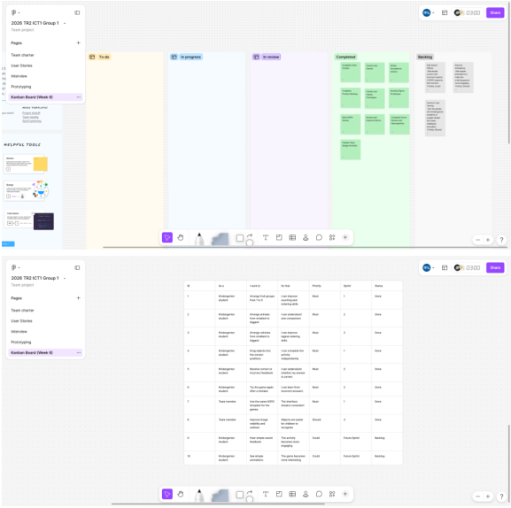
My Contribution
03
Role: Game Designer / Scrum Coordinator
Design Artefacts
• 3 ordering concepts
• 3 Figma prototypes
• 3 KOPO games
• Screenshots / notes
Requirements
• User stories
• Acceptance criteria
• Story size
• Sprint backlog
Iteration
• Feedback review
• Clearer wording
• Image visibility
• Layout consistency
Bohong Wang | Ordering Game Design

Slide 4
User Stories
04
Theme 1
Theme 2
Theme 3
Fruit — Order 1 to 5
User Need
Counting + ordering
Acceptance
• 5 fruit groups
• Drag & drop
• Feedback
Story Size: S
Animals — Smallest to Biggest
User Need
Size comparison
Acceptance
• Mixed animal cards
• Empty drop spaces
• Correct size order
Story Size: M
Vehicles — Smallest to Biggest
User Need
Logical ordering
Acceptance
• Mixed vehicle cards
• Empty drop spaces
• Correct size order
Story Size: M
Bohong Wang | Ordering Game Design

Slide 5
Sprint Pilot Backlog
05
Learner-focused tasks + clear learning purpose
01
Arrange objects
Counting / size order
02
Drag & drop
Independent play
03
Compare quantity / size
Recognise differences
04
Feedback + retry
Learn from mistakes
Applied to: Fruit • Animals • Vehicles
Bohong Wang | Ordering Game Design

Slide 6
Scrum Process
06
Sprint Planning → Prototype → Review → Feedback → Retrospective → Improvement
Sprint Review
• Demo games
• Check layout
• Collect feedback
Feedback Evidence
• Question clarity
• Image visibility
• Template consistency
Retrospective Action
• Better wording
• Image outlines
• Shared checklist
Bohong Wang | Ordering Game Design

Slide 7
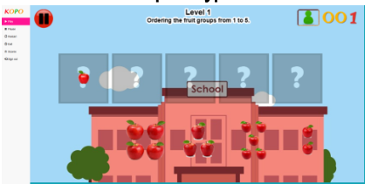
Sprint Pilot 1 — Fruit Ordering
07
Sprint Goal
Counting 1–5
Design Decision
Familiar fruits + drag & drop
Feedback
Unclear question + visual issues
Evidence: KOPO prototype screenshot
Figma prototype
KOPO game
Improvement
Clearer wording + better visibility
Bohong Wang | Ordering Game Design

Slide 8
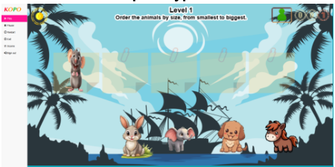
Sprint Pilot 2 — Animal Ordering
08
Sprint Goal
Smallest → biggest
Design Decision
Clear size gaps + same controls
Feedback
Instruction + layout + images
Evidence: KOPO prototype screenshot
Figma prototype
KOPO game
Improvement
Consistent KOPO template
Bohong Wang | Ordering Game Design

Slide 9
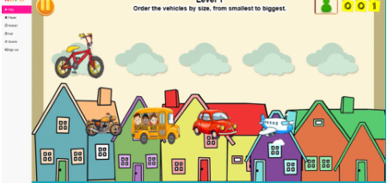
Sprint Pilot 3 — Vehicle Ordering
09
Sprint Goal
Smallest → biggest
Design Decision
Clear vehicles + simple interaction
Feedback
Low contrast + sound optional
Evidence: KOPO prototype screenshot
Figma prototype
KOPO game
Improvement
Stronger outlines + minor layout changes
Bohong Wang | Ordering Game Design

Slide 10
Constraints & Trade-offs
10
Main Constraints
• Time limit
• KOPO functions
• Image quality
• Limited child testing
Design Trade-offs
• Variety vs. consistency
• Multimedia vs. simplicity
• Decoration vs. clarity
• Unique theme vs. shared controls
Priority: clarity • visibility • drag-and-drop • feedback • retry
Bohong Wang | Ordering Game Design

Slide 11
Reflection & Conclusion
11
Achieved
• 3 ordering games
• Figma + KOPO
• Feedback iteration
• Evidence kept
Learned
• Direct instructions
• Visible images
• Consistent layout
• Small details matter
Next Improvement
• Test KOPO earlier
• Check criteria first
• More user testing
• Record actions
Final message: clear • testable • age-appropriate ordering games
Bohong Wang | Ordering Game Design

